Slide 1
IMBA

Slide 2
IMBA Orientation
2023.09.08

Slide 3
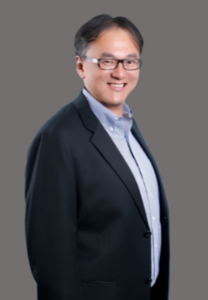
IMBA Director
Professor: Shih Wei Wu
Lab：Technology Building 1017
TEL：(02)2771-2171 ext. 3424
Email： swu@ntut.edu.tw; shihwei1976@gmail.com

Slide 4
Degree Requirements

Slide 5
Degree Requirements * Minimum 3 credits / maximum 13 credits each semester
7 Credits
Required Courses
30 Credits
Elective Courses
6 Credits
Thesis
43 credits
A minimum of 37 credits of courses plus 6 credits of thesis work is required for graduation.
The curriculum is divided into required and elective courses.
● IMBA Required courses (13 credits in total):
Business Ethics & Sustainability Management - 2 credits
Journal Study and Discussion- 2 credits
Research methods - 3 credits
Thesis courses (total -6 credits, 2 semester courses).

Slide 6
Degree Requirements * Minimum 3 credits / maximum 13 credits each semester
7 Credits
Required Courses
30 Credits
Elective Courses
6 Credits
Thesis
43 credits
A minimum of 37 credits of courses plus 6 credits of thesis work is required for graduation.
The curriculum is divided into required and elective courses.
● IMBA Elective Courses (minimum: 30 credits, 10 courses)
must contain : Required-Elective Courses(choose 4 from 6 )
◎Strategic Management ◎Financial Management
◎Management Science ◎Management Accounting
◎Information Management ◎ Marketing Management

Slide 7
Attendance & Sick leave
Attendance
Go to classroom on time
Attendance is a way to show your attitude and may affect your grade.
Mail your teacher to inform your situation
Sick leave
Need to provide a proof from a doctor
During midterm, must file a formal request online.

Slide 8
Deadline
Taiwan Time Zone
Assignment, homework, presentation and so on.
i-School, E-learning , NTUT email
No excuse!! (Affects your grade hugely!)

Slide 9
Add/drop course
Add/drop course selection system
Starts from Sep 11th 2023 at 9:00 AM
Ends on Sep 22nd 2023 at 5:00 PM
Chinese and other course in undergraduate school
No credit fee
Can’t be counted into your graduation credits
The grade will list on your transcript

Slide 10
Credit transfer
Master program credits only
The credits must not be counted into a graduation credits in the previous school
Provide an official transcript (with grade)
Notice: you can file a request, but no guarantee to pass it!!

Slide 11
Work Permit
Search “NTUT Work Permit”
Print & fill out the form
Bring the form to Sean for stamp
Upload (Please follow the instruction)
https://oia.ntut.edu.tw/

Slide 12
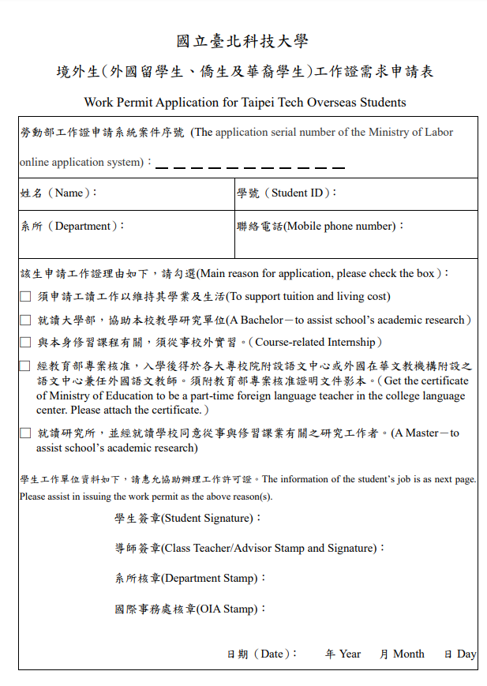
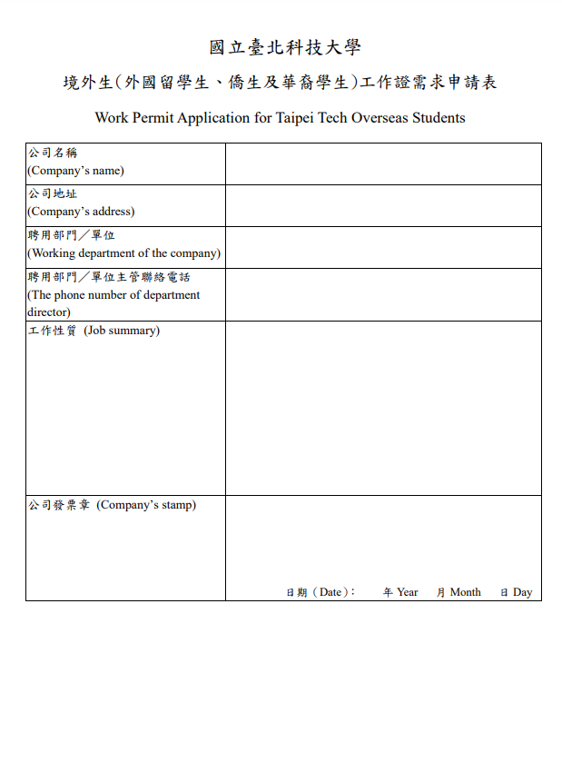

Slide 13
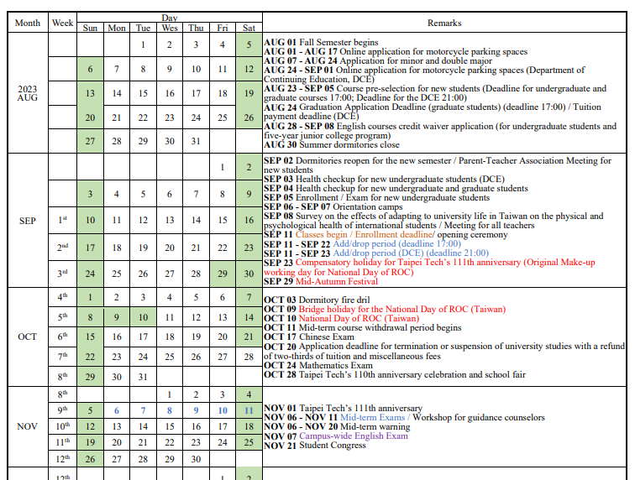
Taipei Tech’s Calendar
https://oia.ntut.edu.tw/

Slide 14
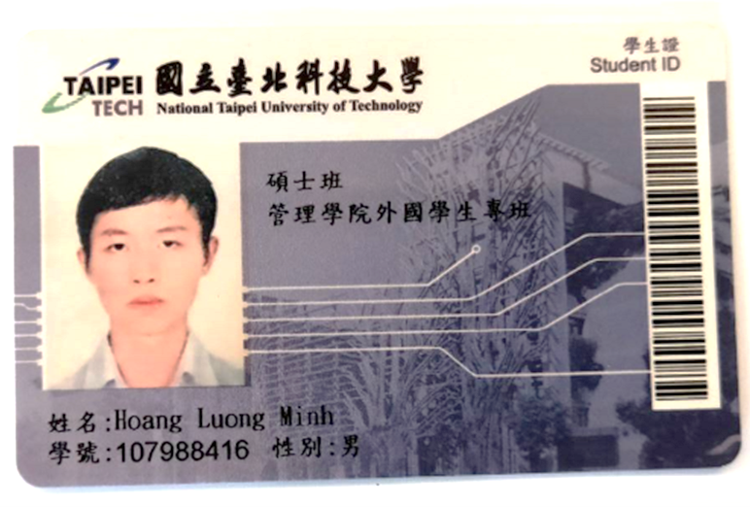
Student ID Card
Make sure the order of your name is correct.
The name will show on your transcript and diploma.
Bring your passport to OIA to fix within a week while you received your ID card.

Slide 15
Thesis Procedure
Thesis Advisor
The first year
Thesis Proposal
The 1st semester of the 2nd year
Oral final defense
The 2nd semester of the 2nd year
Complete the first 3 chapters
Proposal Presentation
Full-time Faculty

Slide 16
Thesis Requirement
Graduation thesis must be submitted to a seminar or conference in school or off-campus before graduation.
The thesis credits will be approved after receiving thesis acceptance certificate.

Slide 17
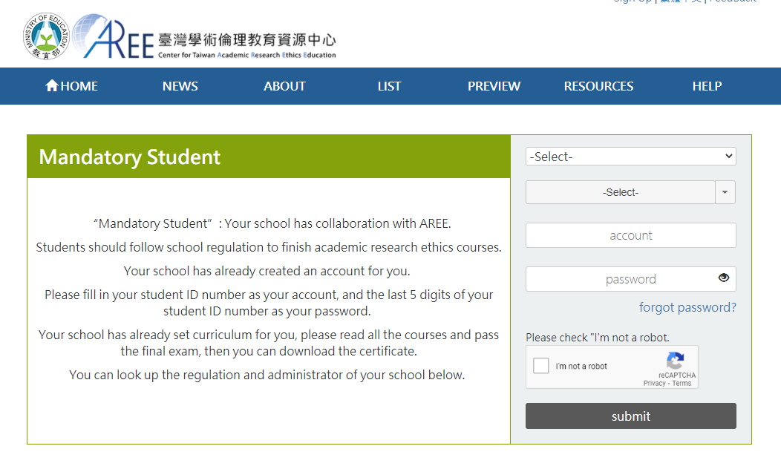
Academic Research Ethics Course (Online)
6 hours course
After course exam
(Your grade needs to reach 85 or higher)
Must finish it for graduation

